Slide 1
University of Diyala
College of Engineering
Department of Electronics Engineering
Course Number: U103
Course Name: Computer Science
Lecture (4)
Asst. Lect. Wurod Qasim Mohamed

Slide 2
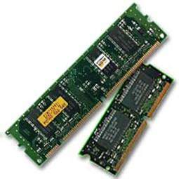
RAM (Random Access Memory)
RAM (Random Access Memory) is the internal memory of the CPU for storing data, program, and program result. It is a read/write memory which stores data until the machine is working. As soon as the machine is switched off, data is erased.

Slide 3
Access time in RAM is independent of the address, that is, each storage location inside the memory is as easy to reach as other locations and takes the same amount of time. Data in the RAM can be accessed randomly but it is very expensive.
RAM is volatile, i.e. data stored in it is lost when we switch off the computer or if there is a power failure. Hence, a backup Uninterruptible Power System (UPS) is often used with computers. RAM is small, both in terms of its physical size and in the amount of data it can hold.
RAM is of two types :
Static RAM (SRAM)
Dynamic RAM (DRAM)

Slide 4
Static RAM (SRAM)
The word static indicates that the memory retains its contents as long as power is being supplied. However, data is lost when the power gets down due to volatile nature. SRAM chips use a matrix of 6-transistors and no capacitors. Transistors do not require power to prevent leakage, so SRAM need not be refreshed on a regular basis.

Slide 5
There is extra space in the matrix, hence SRAM uses more chips than DRAM for the same amount of storage space, making the manufacturing costs higher. SRAM is thus used as cache memory and has very fast access.
Characteristic of Static RAM
Long life
No need to refresh
Faster
Used as cache memory
Large size
Expensive
High power consumption

Slide 6
Dynamic RAM (DRAM)
DRAM, unlike SRAM, must be continually refreshed in order to maintain the data. This is done by placing the memory on a refresh circuit that rewrites the data several hundred times per second. DRAM is used for most system memory as it is cheap and small. All DRAMs are made up of memory cells, which are composed of one capacitor and one transistor.

Slide 7
Characteristics of Dynamic RAM
Short data lifetime
Needs to be refreshed continuously
Slower as compared to SRAM
Used as RAM
Smaller in size
Less expensive
Less power consumption

Slide 8
Practical Laboratory Part

